Slide 1
Final Artifact
Thomas Kugelman, Merve Vakkasoglu, Michael Hajjar, Nathaniel Malone, Sumanth Subrahmanya

Slide 2
Problem
This area has high demand for technology manufacturing as well as residential housing.

Slide 3
Solution
-Utilize Planner5D Web software, with a team member as the “driver.”
-Team members take the responsibility of individual User Stories and Trello Cards by helping the driver design each User Story.

Slide 4
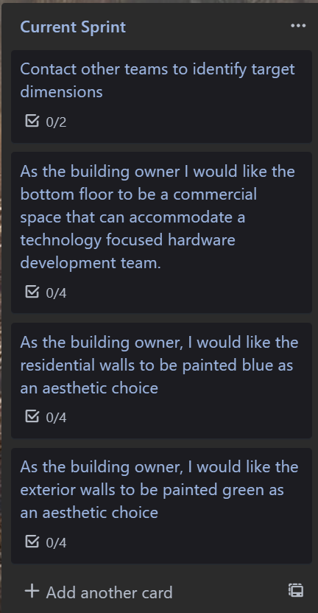
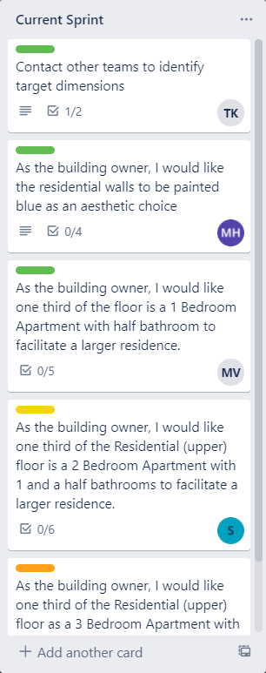
SprintSprint 1 - First Floor
Sprint 2 - Second Floor
Sprint Backlog

Slide 5
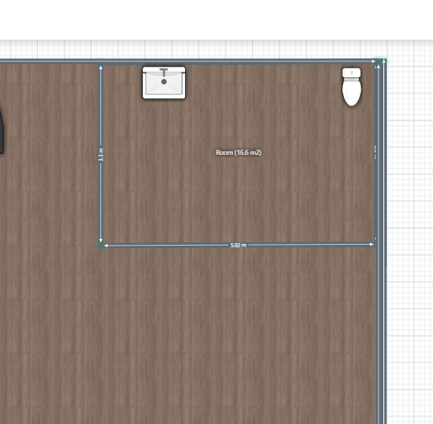
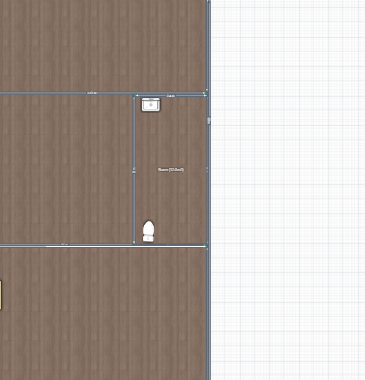
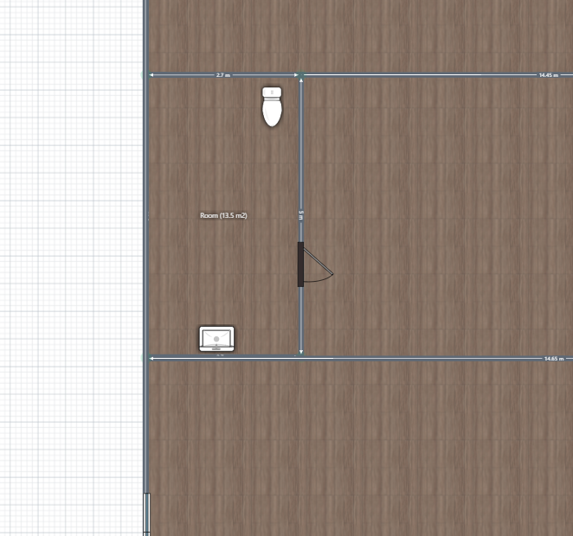
First floor bathrooms

Slide 6
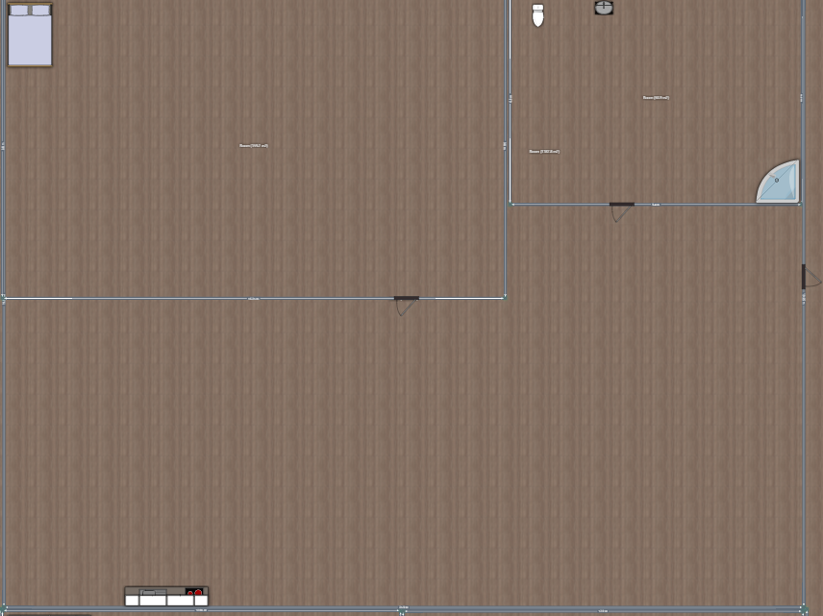
One bedroom apartment

Slide 7
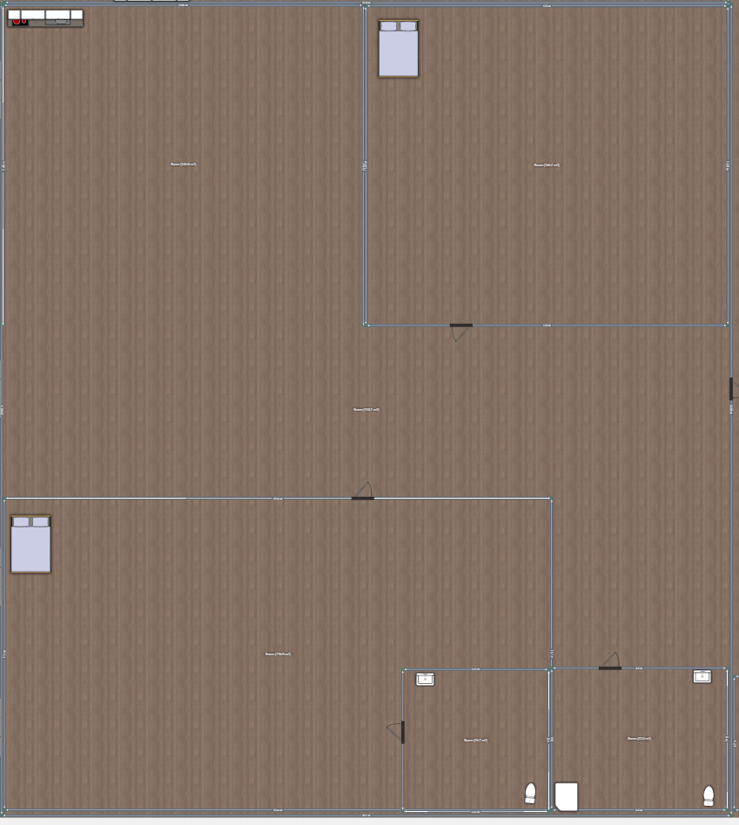
Two bedroom apartment

Slide 8
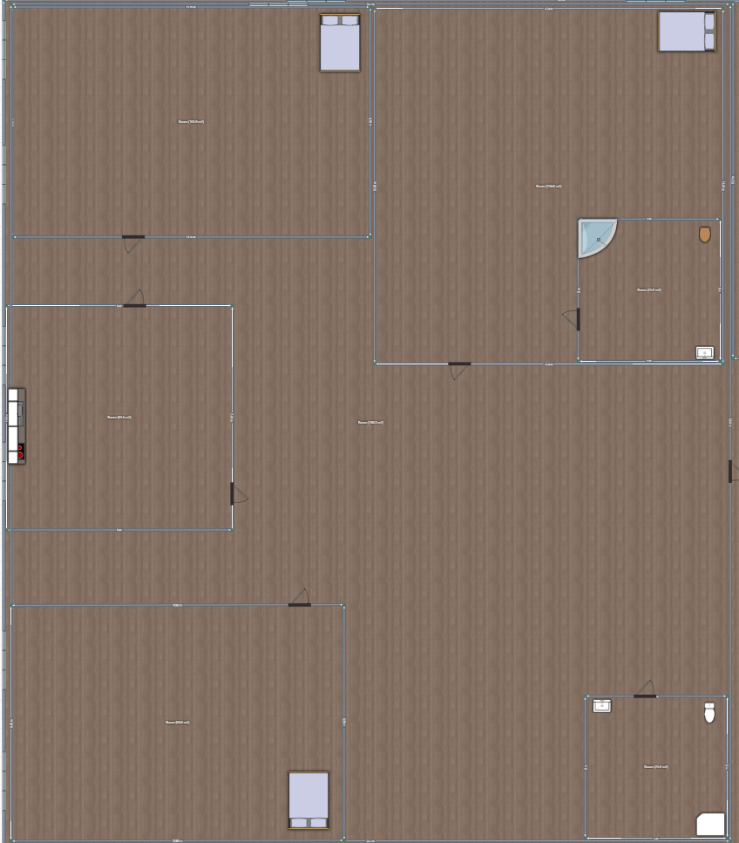
Three bedroom apartment

Slide 9
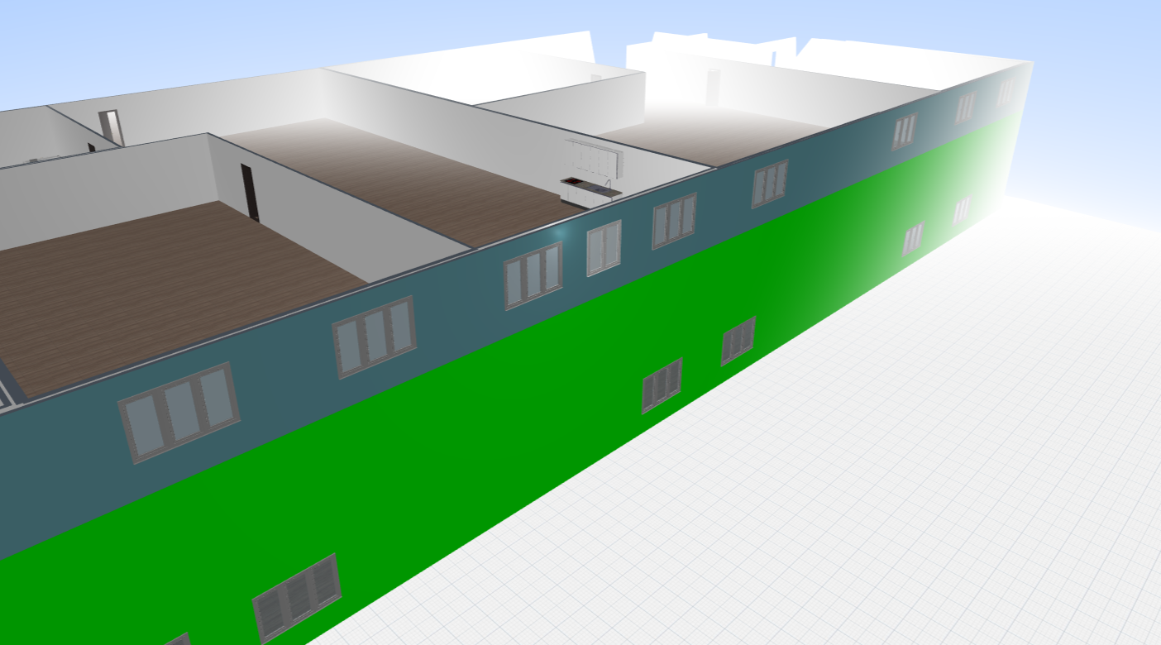
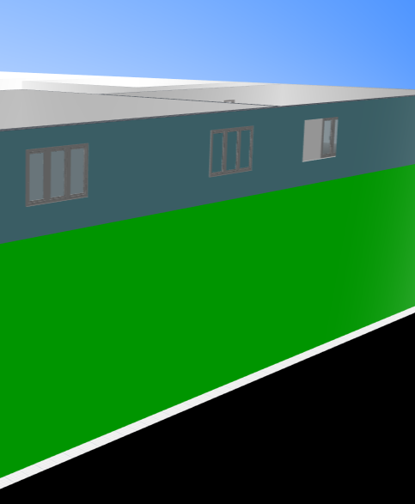
This area has high demand for technology manufacturing as well as residential housing.
Colored Walls and Windows

Slide 10
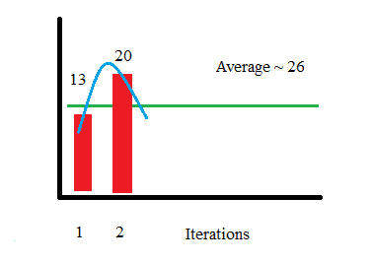
Potential Improvements
Spend more time:
-planning
-editing design in Planner5D

